Slide 1
Lecture 2
Introduction to Intel Architecture and Programming

Slide 2
Getting to the nuts and bolts
Any (modern) operating systems require hardware support
The kind of support needed is generally the same but the details differ depending on the processor architecture
We will focus on Intel x86
Requires basic knowledge of computer architecture
Need to learn basic assembly programming

Slide 3
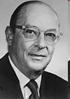
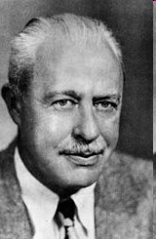
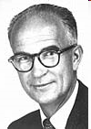
A small digression – history of semiconductors
In the beginning… there was the transistor
John Bardeen
(1908-1991)
William Shockley
(1910-1989)
Walter Houser Brattain
(1902-1987)
Won a second Nobel prize for Physics in 1972!
The 1956 Nobel Prize in Physics
"for their researches on semiconductors and their discovery of the transistor effect"

Slide 4
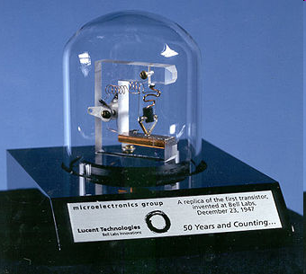
On December 23, 1947…
A single invention was to change the world

Slide 5
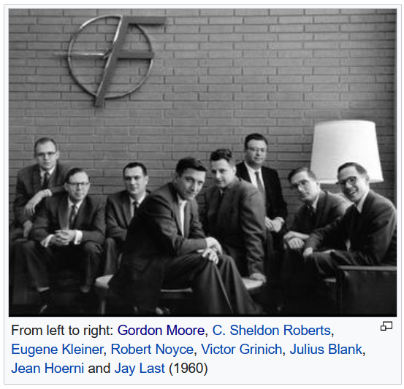
And Silicon Valley came to be
In 1956, William Shockley opened Shockley Semiconductor Laboratory
In 1957, Shockley and eight others started Fairchild Semiconductors
The traitorous eight left Fairchild and started various ventures in semiconductors
Robert Noyce and Gordon Moore founded Intel Corp. in 1968
In 1969, another group of Fairchild engineers founded AMD
Most in today’s Silicon Valley area
Source: Wikipedia

Slide 6
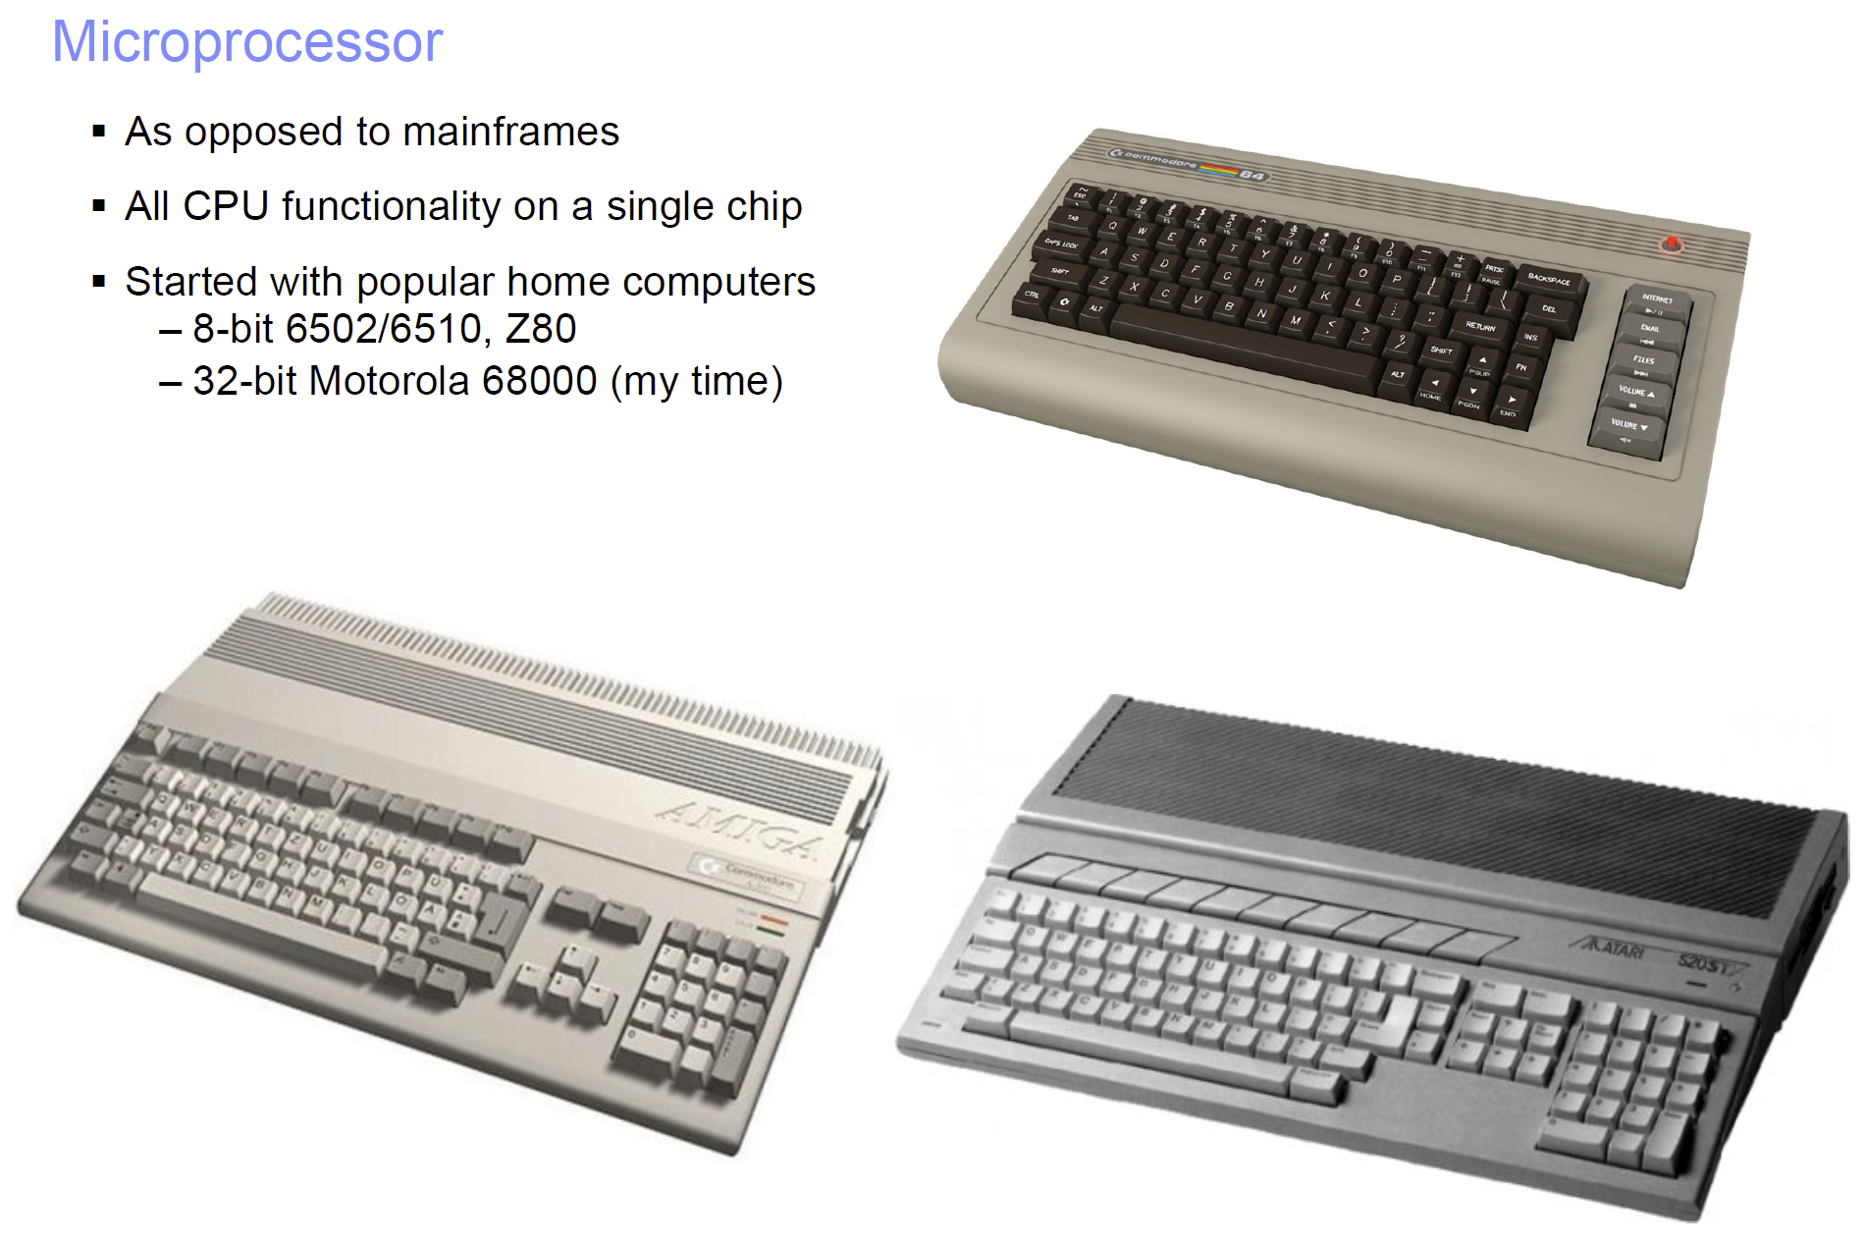
The first single chip microprocessor, the 4004, invented by a group of Intel engineers and released in 1971.

Slide 7
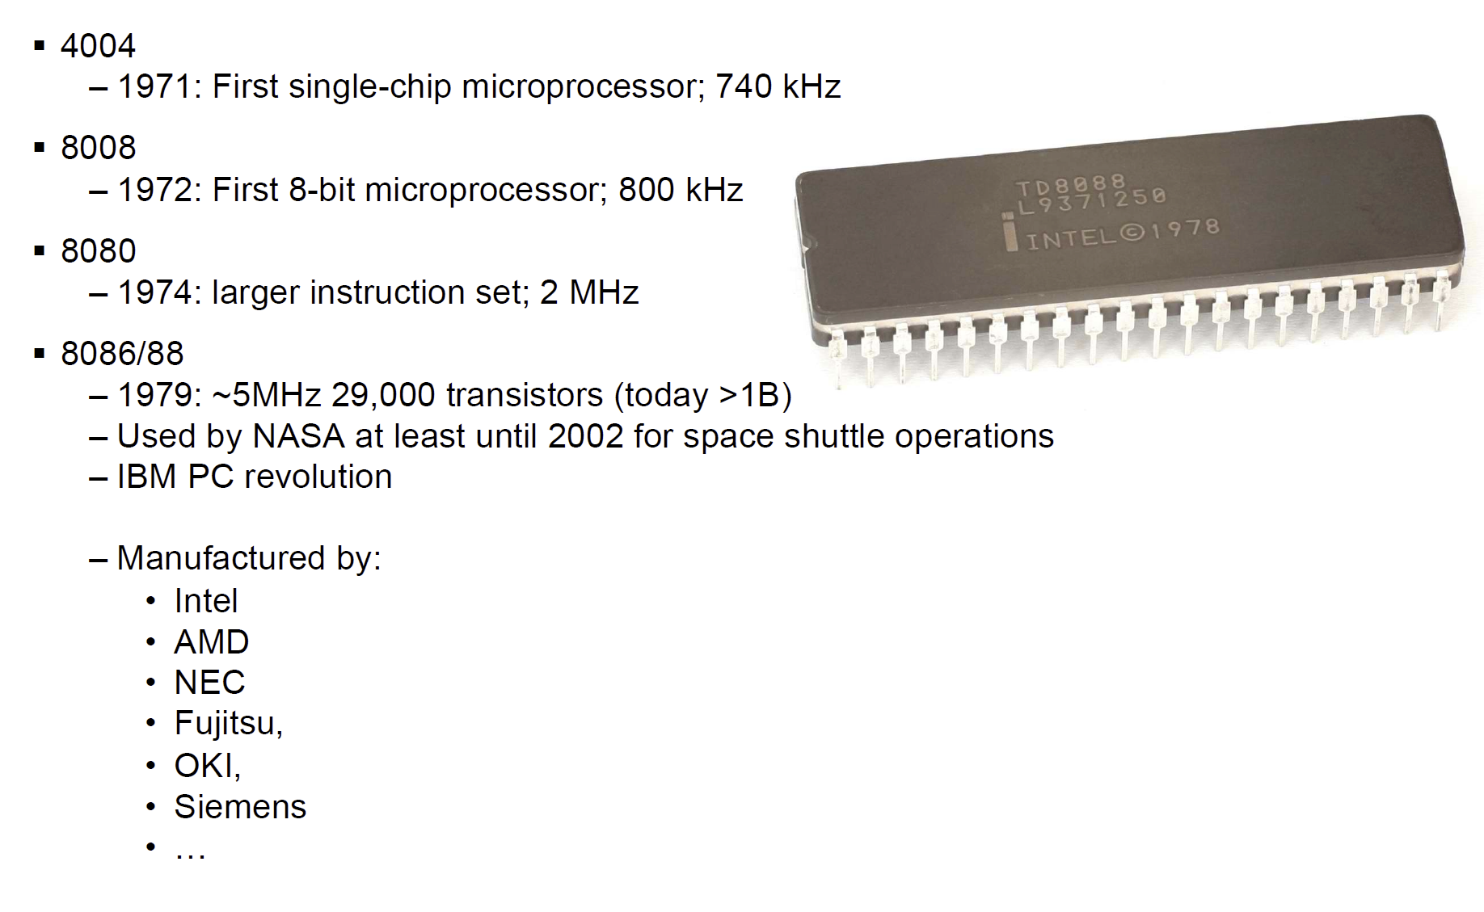
History

Slide 8
Intel Microprocessors
Intel introduced the 8086 microprocessor in 1979
8086, 8087, 8088, and 80186 processors
16-bit processors with 16-bit registers
16-bit data bus and 20-bit address bus
Physical address space = 2²⁰ bytes = 1 MB
8087 Floating-Point co-processor
Uses segmentation and real-address mode to address memory
Each segment can address 2¹⁶ bytes = 64 KB
8088 is a less expensive version of 8086
Uses an 8-bit data bus
80186 is a faster version of 8086

Slide 9
Intel 80286 and 80386 Processors
80286 was introduced in 1982
24-bit address bus ⇒ 2²⁴ bytes = 16 MB address space
Introduced protected mode
Segmentation in protected mode is different from the real mode
80386 was introduced in 1985
First 32-bit processor with 32-bit general-purpose registers
First processor to define the IA-32 architecture
32-bit data bus and 32-bit address bus
2³² bytes ⇒ 4 GB address space
Introduced paging, virtual memory, and the flat memory model
Segmentation can be turned off

Slide 10
Intel 80486 and Pentium Processors
80486 was introduced 1989
Improved version of Intel 80386
Crossed the million transistor mark
On-chip Floating-Point unit (DX versions)
On-chip unified Instruction/Data Cache (8 KB)
Uses Pipelining: can execute up to 1 instruction per clock cycle
Pentium (80586) was introduced in 1993
Wider 64-bit data bus, but address bus is still 32 bits
Two execution pipelines: U-pipe and V-pipe
Superscalar performance: can execute 2 instructions per clock cycle
Separate 8 KB instruction and 8 KB data caches
MMX instructions (later models) for multimedia applications

Slide 11
Intel P6 Processor Family
P6 Processor Family: Pentium Pro, Pentium II and III
Pentium Pro was introduced in 1995
Three-way superscalar: can execute 3 instructions per clock cycle
36-bit address bus ⇒ up to 64 GB of physical address space
Introduced dynamic execution
Out-of-order and speculative execution
Integrates a 256 KB second level L2 cache on-chip
Pentium II was introduced in 1997
Added MMX instructions (already introduced on Pentium MMX)
Pentium III was introduced in 1999
Added SSE instructions and eight new 128-bit XMM registers

Slide 12
Pentium 4 and Xeon Family
Pentium 4 is a seventh-generation x86 architecture
Introduced in 2000
New micro-architecture design called Intel Netburst
Very deep instruction pipeline, scaling to very high frequencies
Introduced the SSE2 instruction set (extension to SSE)
Tuned for multimedia and operating on the 128-bit XMM registers
In 2002, Intel introduced Hyper-Threading technology
Allowed 2 programs to run simultaneously, sharing resources
Xeon is Intel's name for its server-class microprocessors
Xeon chips generally have more cache
Support larger multiprocessor configurations

Slide 13
Pentium-M and EM64T
Pentium M (Mobile) was introduced in 2003
Designed for low-power laptop computers
Modified version of Pentium III, optimized for power efficiency
Large second-level cache (2 MB on later models)
Runs at lower clock than Pentium 4, but with better performance
Extended Memory 64-bit Technology (EM64T)
Introduced in 2004
64-bit superset of the IA-32 processor architecture
64-bit general-purpose registers and integer support
Number of general-purpose registers increased from 8 to 16
64-bit pointers and flat virtual address space
Large physical address space: up to 2⁴⁰ = 1 Terabytes

Slide 14
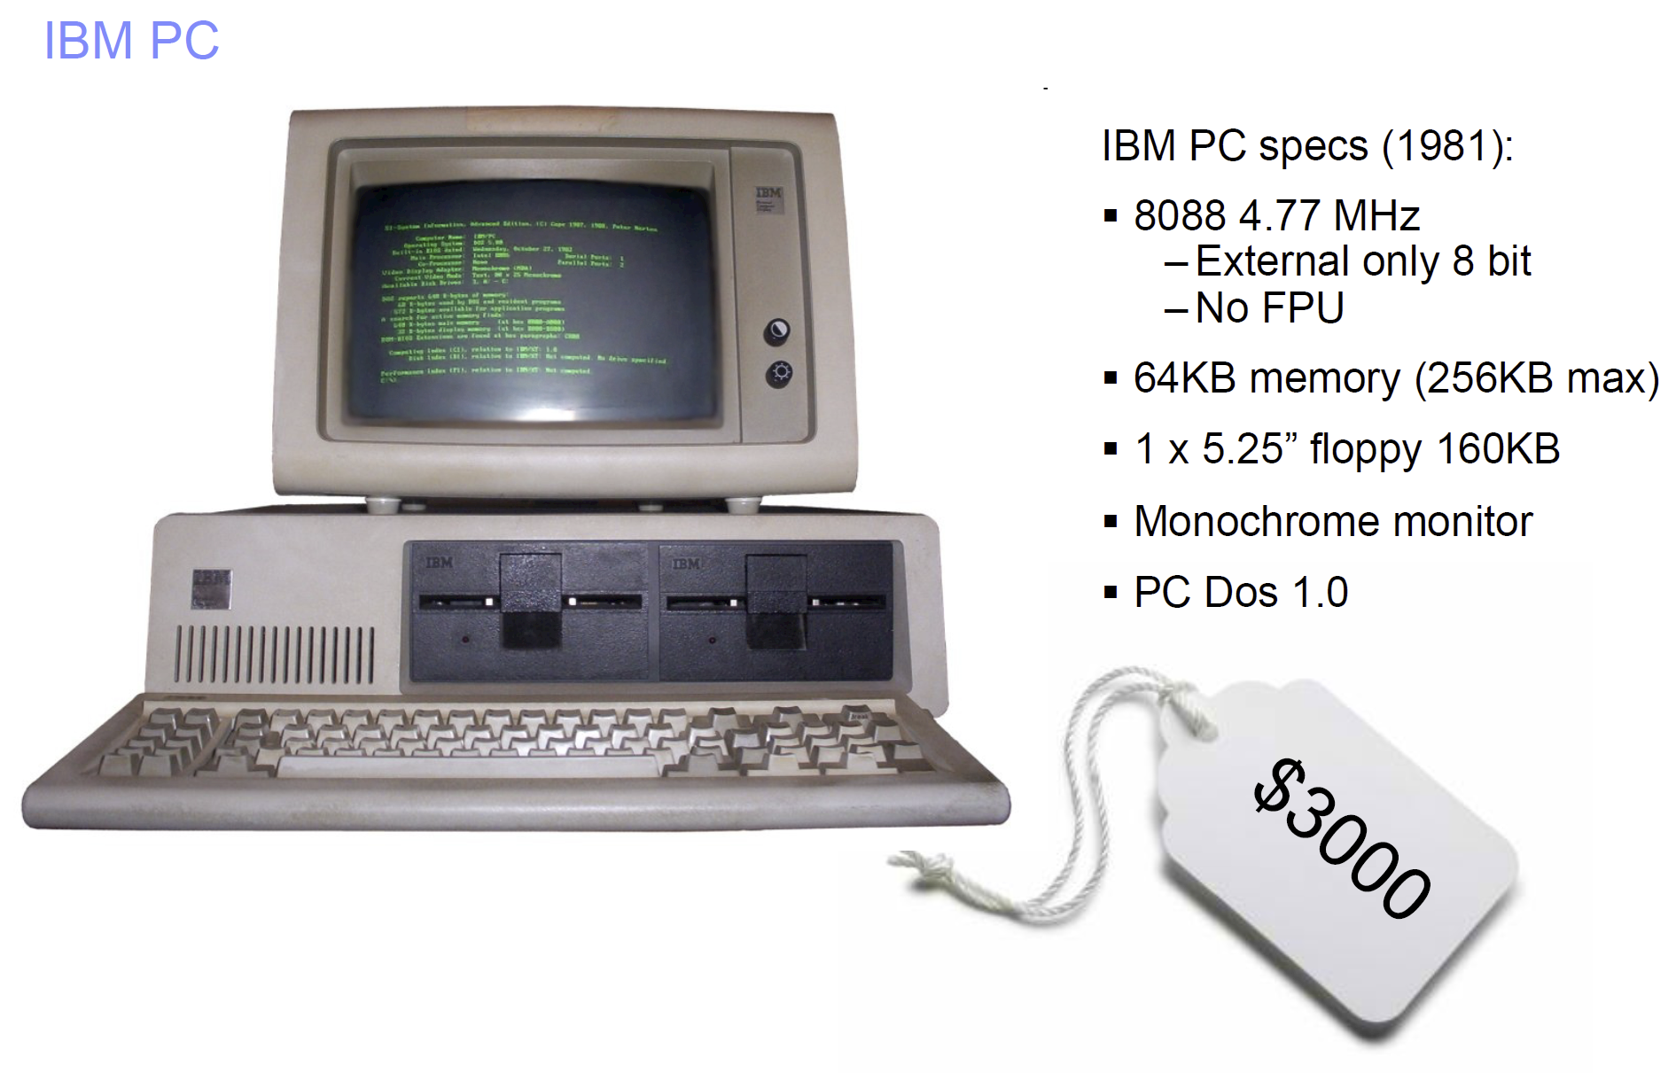
The Big Break

Slide 15
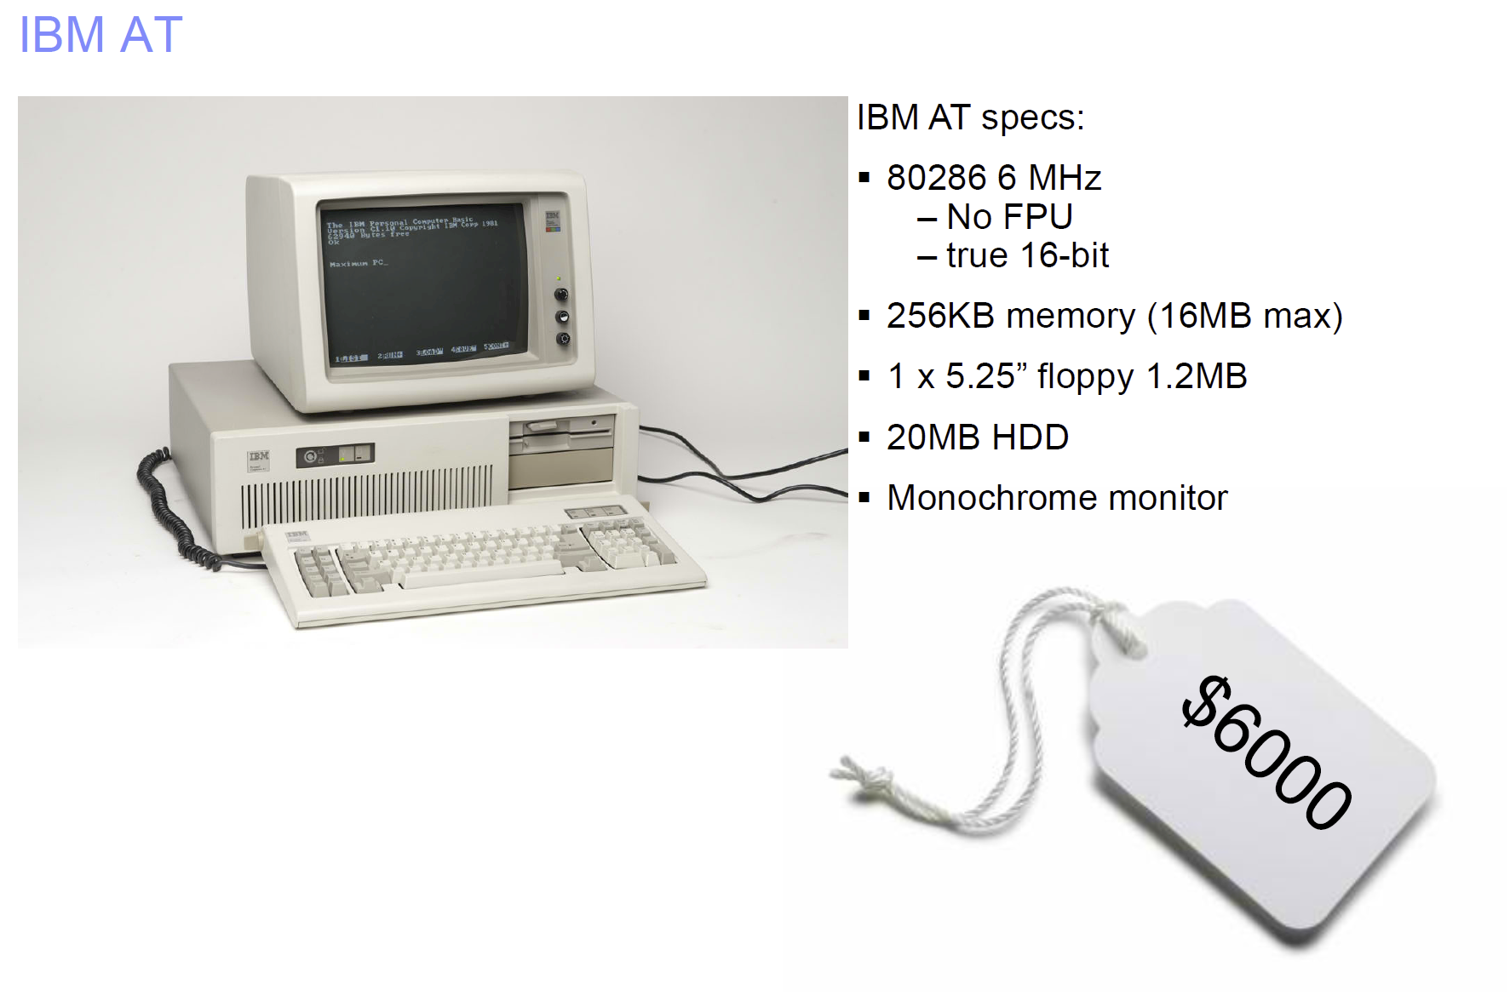
The Second Generation

Slide 16
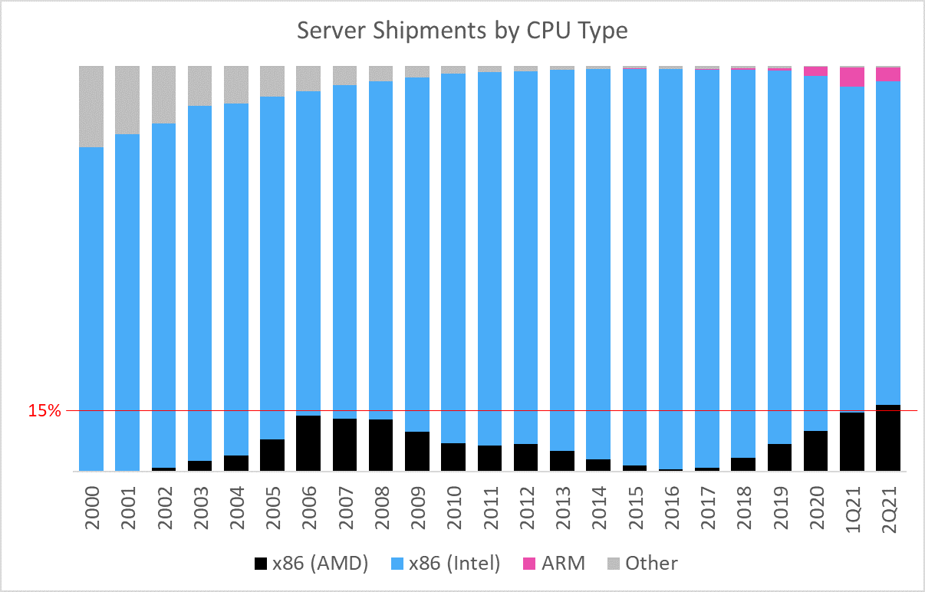
The Dominant Technology
Source: https://omdia.tech.informa.com/blogs/2021/a-historic-data-center-quarter-with-over-15-of-servers-running-on-amd

Slide 17
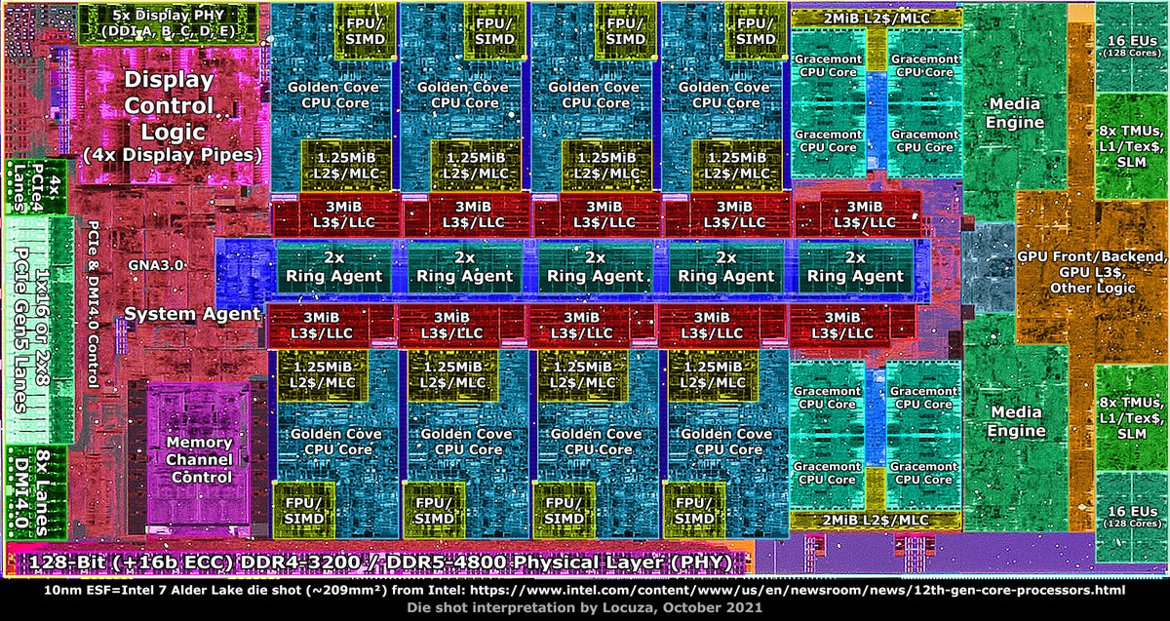
Intel Alder Lake
P-core
E-core

Slide 18
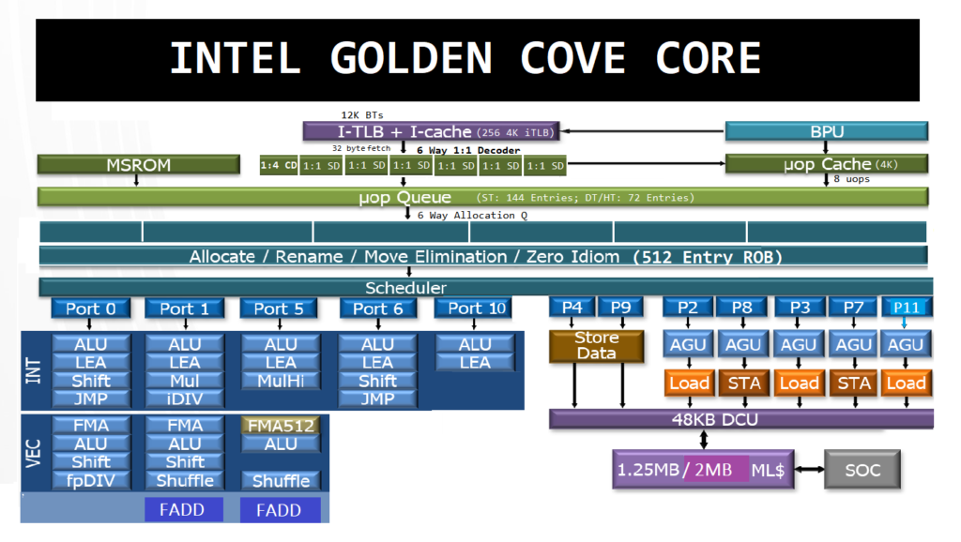
Intel Core Architecture
Source: https://www.hardwaretimes.com/intel-golden-cove-core-architecture-deep-dive-vs-zen-3-and-sunny-cove/

Slide 19
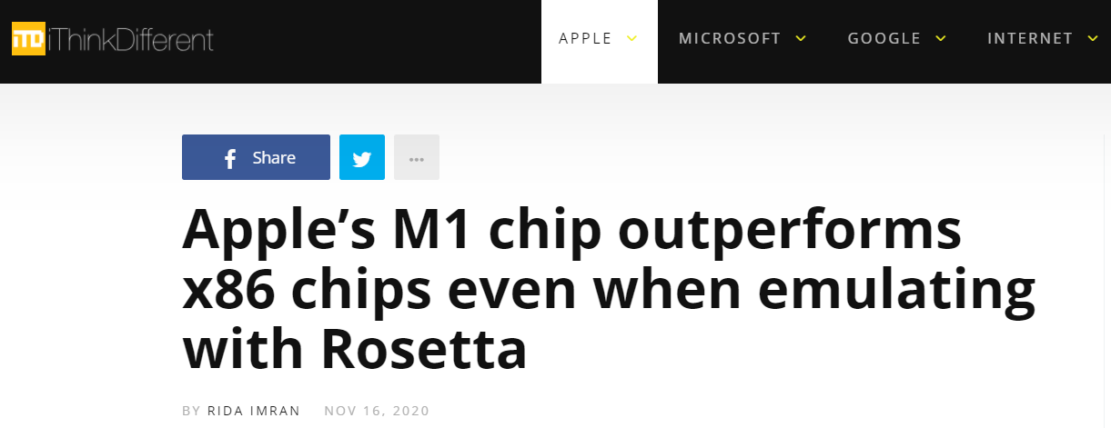
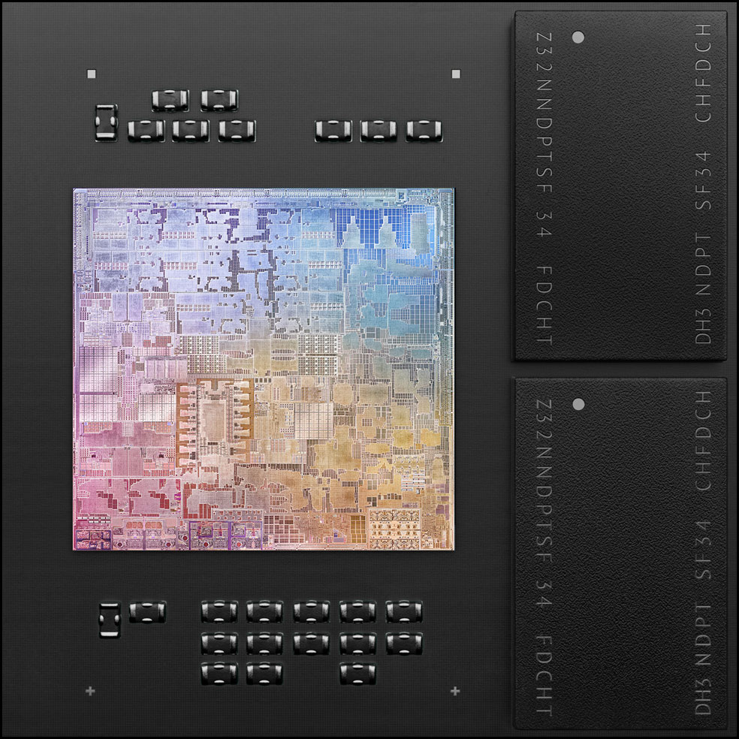
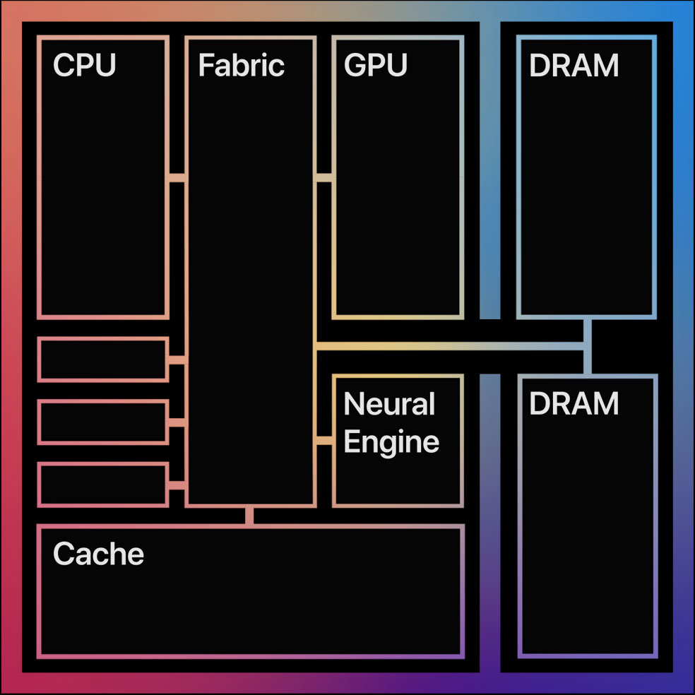
Apple M1

Slide 20
Nomenclature
“IA-32” – 32 bit x86
“Intel 64” – Intel’s version of AMD64 which was AMD’s 64 bit extension of IA-32
“IA-64” – Itanium (dead end)

Slide 21
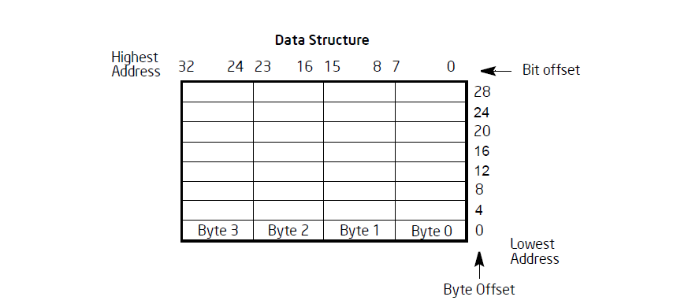
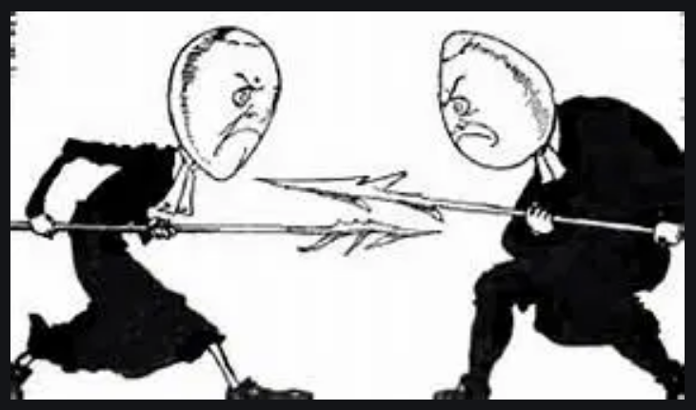
Little Endian

Slide 22
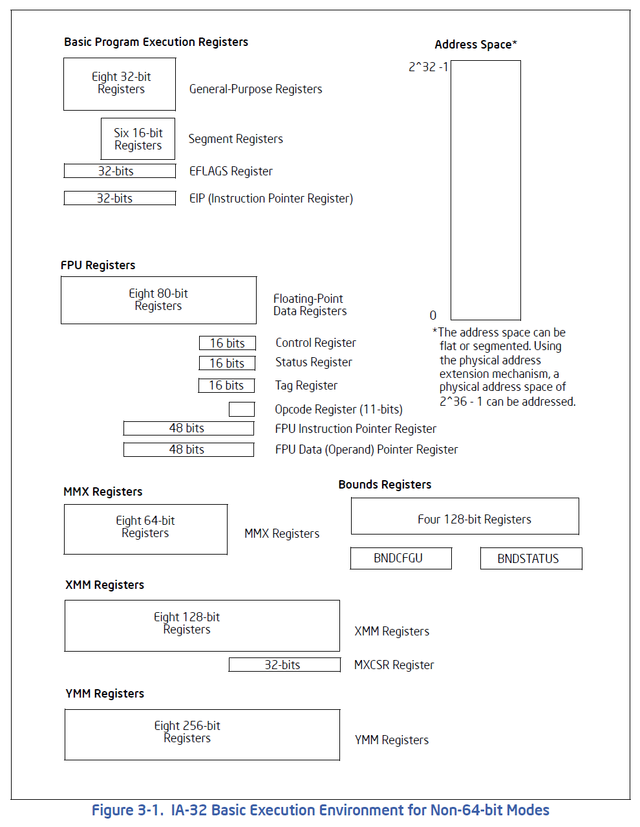
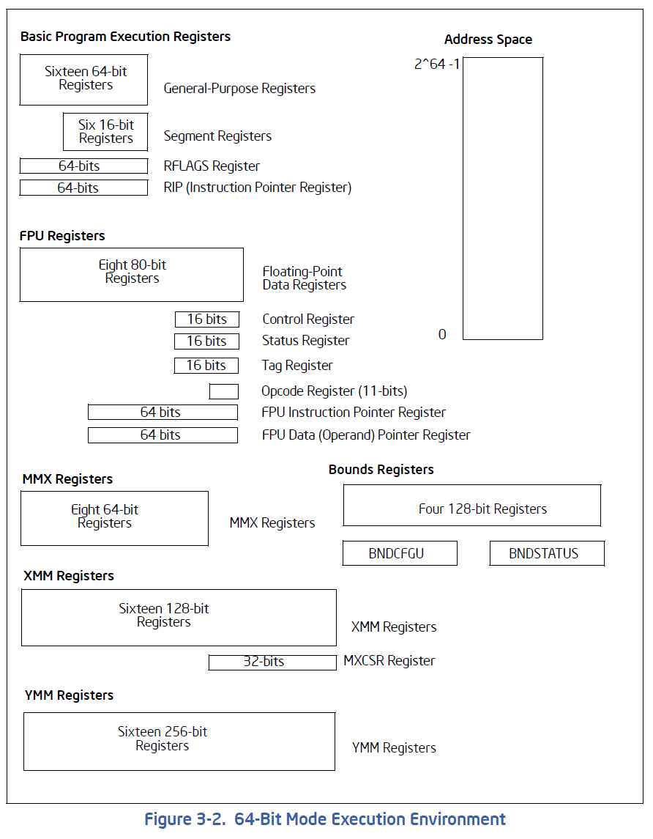
The Registers

Slide 23
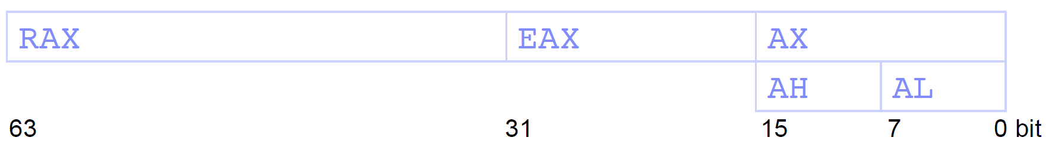
Intel 64 registers
32-bit: EAX (Accumulator), EBX (Base Index), ECX (Counter), EDX (Data), ESI (Source Index), EDI (Destination Index), ESP (Stack Pointer), EBP (Base Pointer), EIP (Instruction Pointer)
16 bit: CS (Code Segment), DS (Data Segment), SS (Stack Segment), ES, FS, GS
64-bit: RAX, RBX, RCX, RDX, RSI, RDI, RSP, RBP, RIP, R8, …, R15

Slide 24

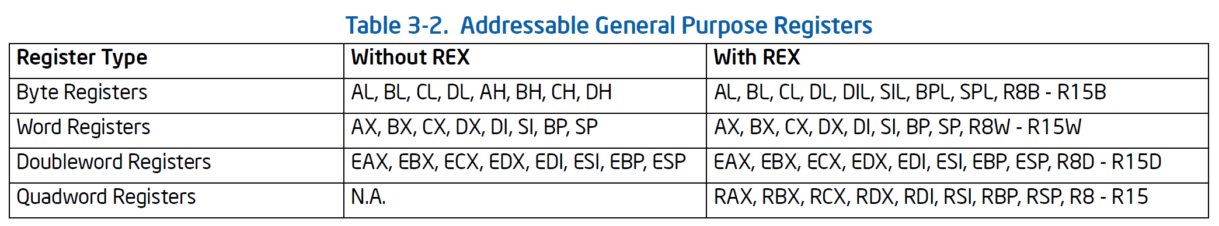
(Sub)register names

Slide 25
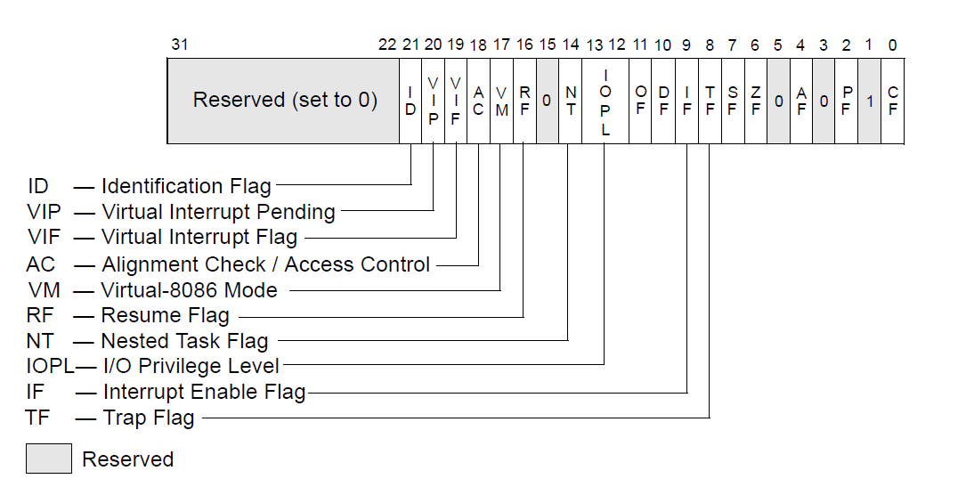
EFLAGS

Slide 26
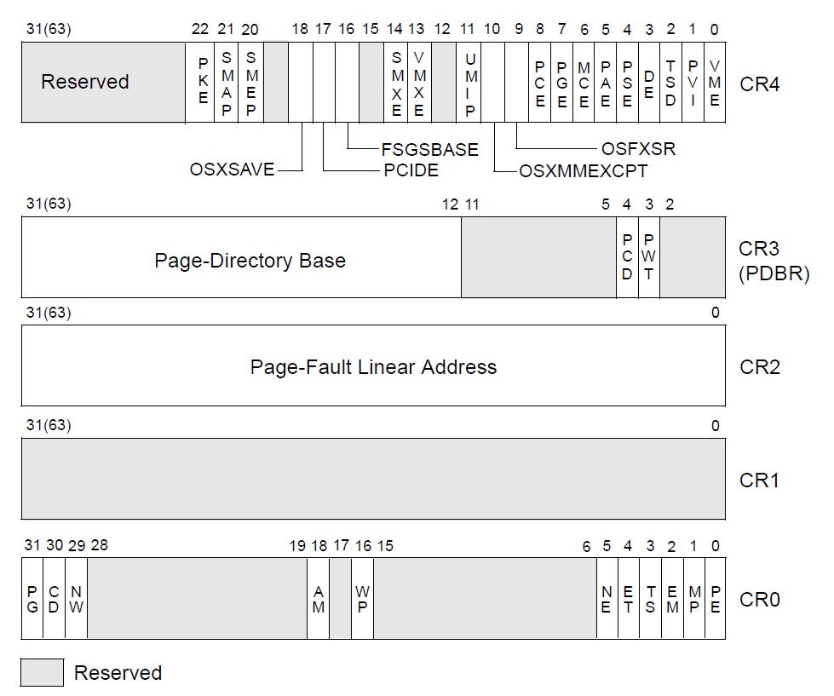
Control Registers

Slide 27
The Operating Modes (1)
Real-address Mode: This mode implements the programming environment of the Intel 8086 processor with extensions (such as the ability to switch to protected or system management mode). The processor is placed in real-address mode following power-up or a reset.
Protected Mode: Normal operation of the processor with virtual memory and privilege rings enabled.
System Management Mode: This mode provides an operating system or executive with a transparent mechanism for implementing platform-specific functions such as power management and system security.

Slide 28
The Operating Modes (2)
Virtual-8086 Mode: This mode allows the processor execute 8086 software in a protected, multitasking environment.
Intel 64 IA-32e Mode: the processor supports two sub-modes: compatibility mode and 64-bit mode. 64-bit mode provides 64-bit linear addressing and support for physical address space larger than 64 GBytes. Compatibility mode allows most legacy protected-mode applications to run unchanged.

Slide 29
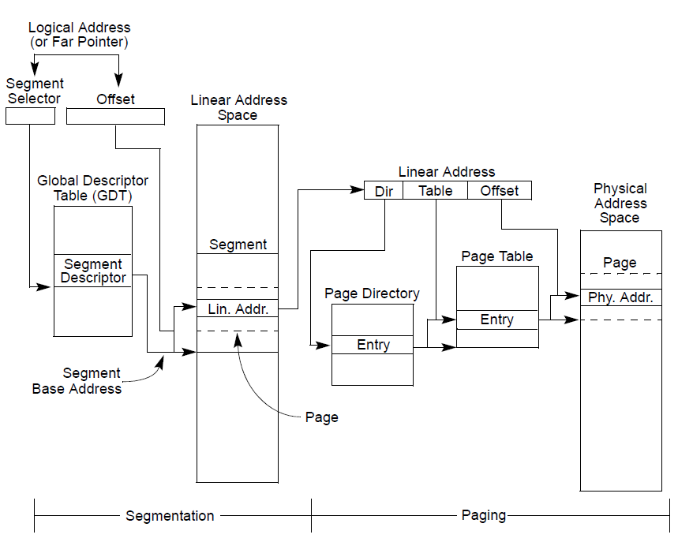
Memory addressing – Segmentation and Paging

Slide 30
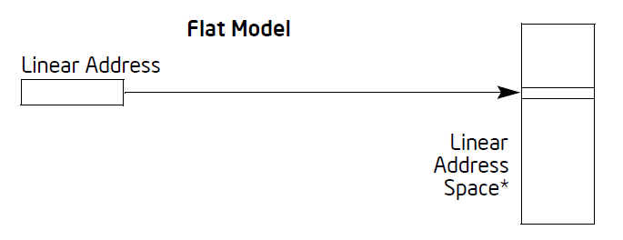
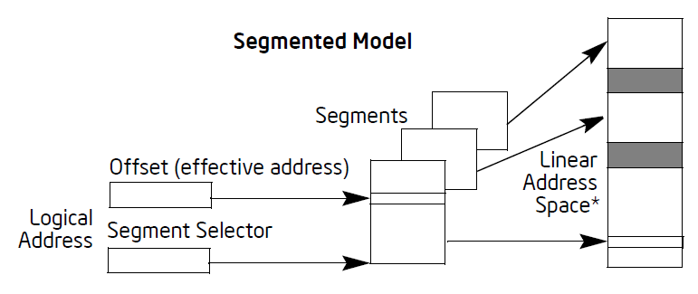
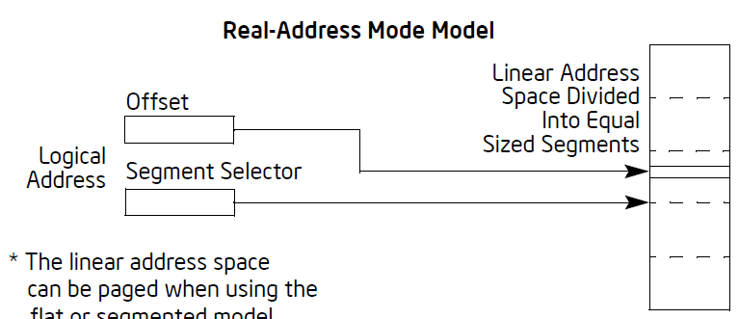
The Three Addressing Models

Slide 31
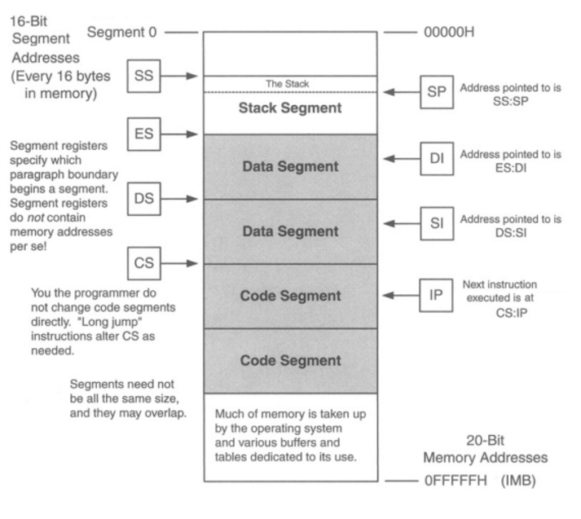
Real-address Mode Model
Physical address = Segment * 16 + Offset

Slide 32
The Modes vs Three Models
Real-address Mode – can only use real-address mode model (i.e., segmented real address)
Protected Mode – can use any of the three models
System Management Mode - processor switches to a separate address space, called the system management RAM (SMRAM) that is similar to the real-address mode model.

Slide 33
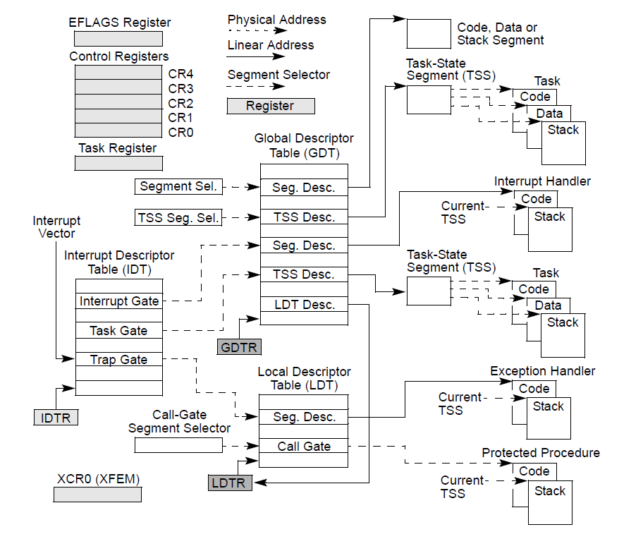
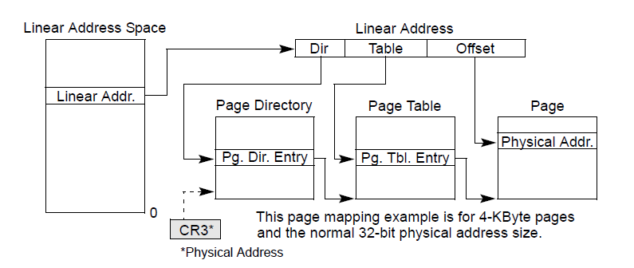
IA-32 System-Level Registers and Data Structures

Slide 34
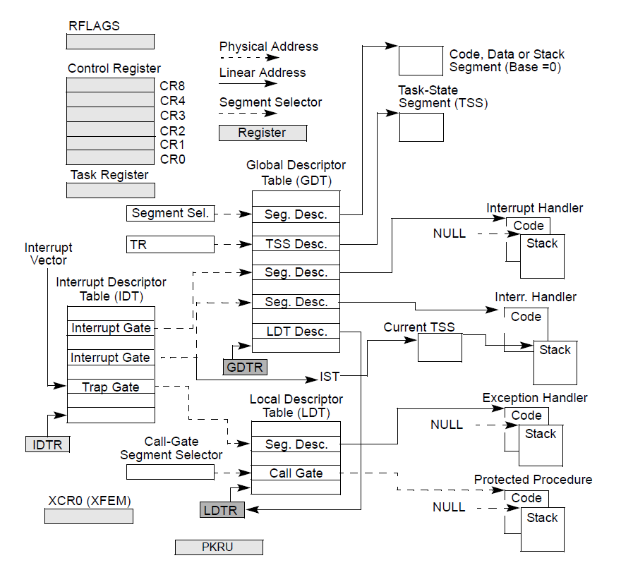
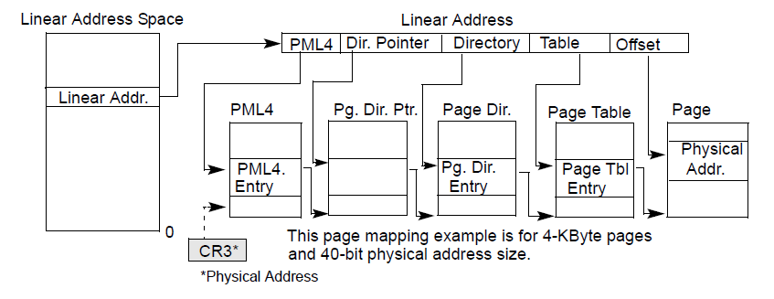
System-Level Registers and Data Structures in IA-32e (64 bit) Mode

Slide 35
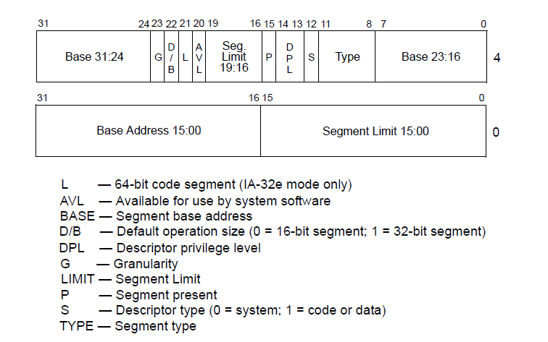
IA-32 Segment Descriptor

Slide 36
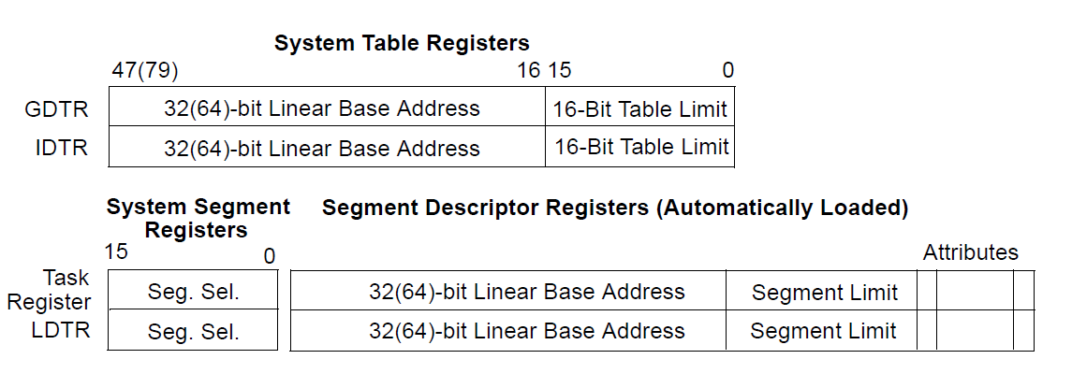
The Descriptor Tables

Slide 37
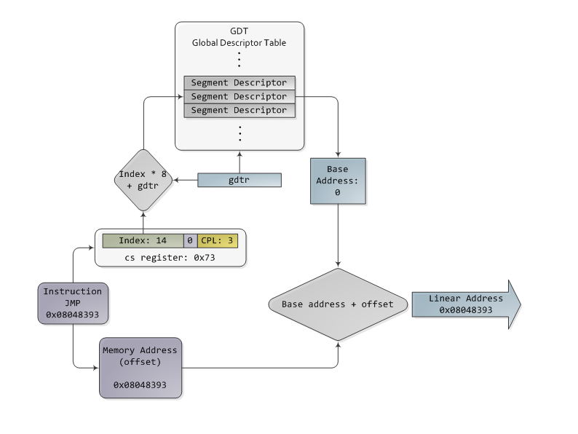
Segment Addressing
Protected mode
Real mode
Segment register * 16 + offset
Example: CS:IP
CS = 0xA01
IP = 0x20
Real address = CS * 16 + IP
= 0xA030
Note: Offset limited to 16 bits
Each segment at most 64KB
Total memory limited to 1MB
TI = 0 – use GDT
TI = 1 – use LDT
T
I
Memory limit – 4 GB
Source: http://duartes.org/gustavo/blog/post/memory-translation-and-segmentation/

Slide 38
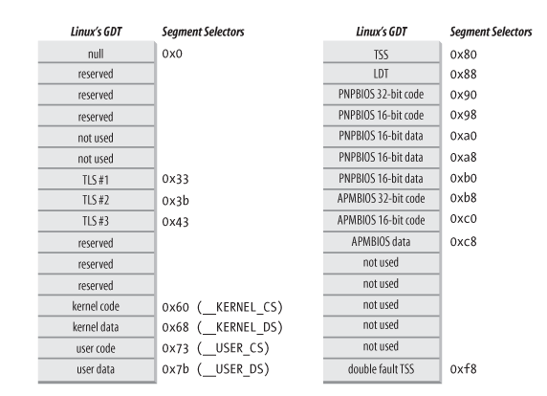
Linux’s GDT

Slide 39
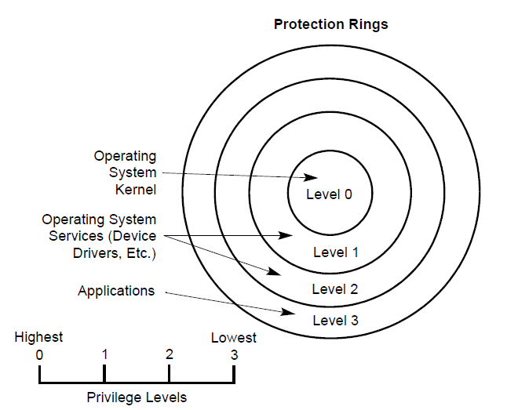
Protection Rings

Slide 40
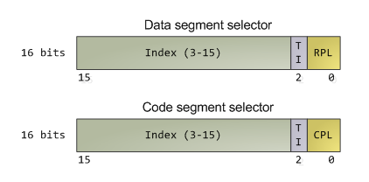
Segment Protection
Two crucial point of protection
when a segment selector is loaded
when a page of memory is accessed with a linear address
All user code runs in Ring 3
All kernel code runs in Ring 0
Current Privilege Level (CPL) – 2 bits in CS register

Slide 41
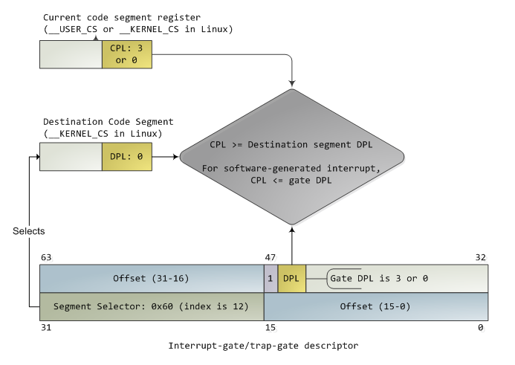
Switching from Ring 3 to Ring 0
Transit due to interrupt using an interrupt-gate (the handler)
Interrupt can never go from higher privilege to lower privilege
Using SYSENTER instruction

Slide 42
Switching from Ring 0 to Ring 3
Through an interrupt return instruction (IRET)
Through SYSEXIT instruction
For more details: http://duartes.org/gustavo/blog/post/cpu-rings-privilege-and-protection/

Slide 43
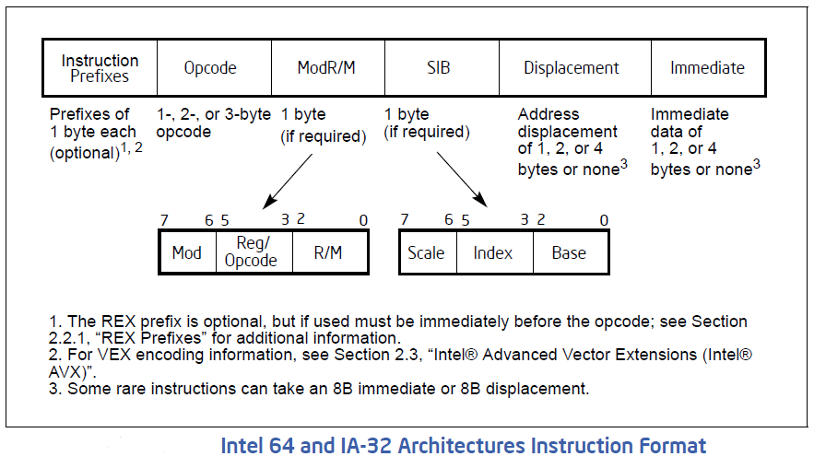
Instruction Encoding

Slide 44
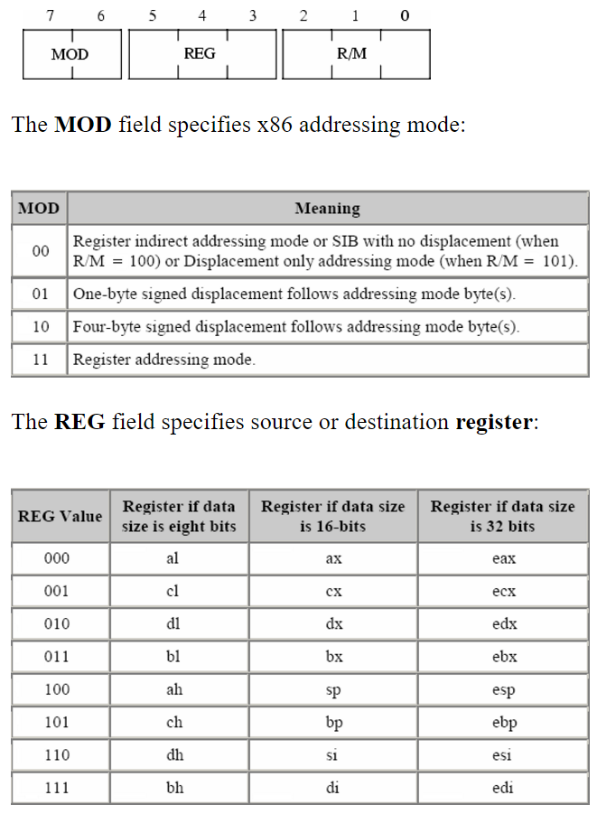
ModRM byte
Source: http://www.c-jump.com/CIS77/CPU/x86/lecture.html

Slide 45
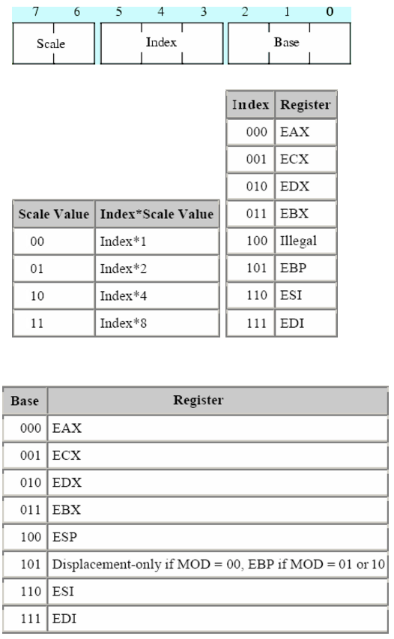
SIB byte

Slide 46
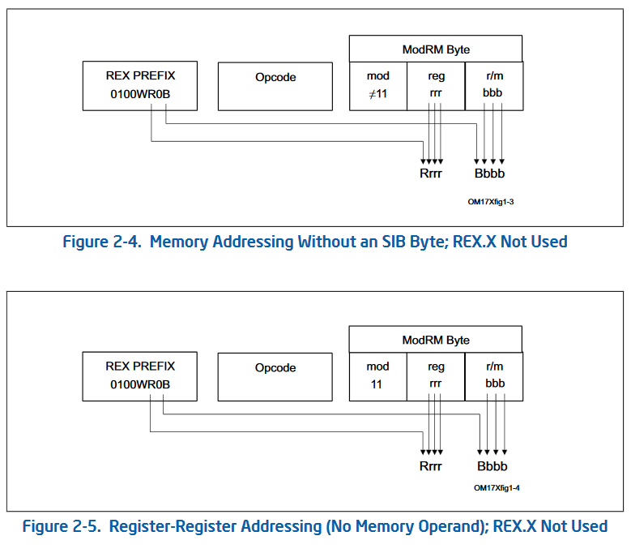
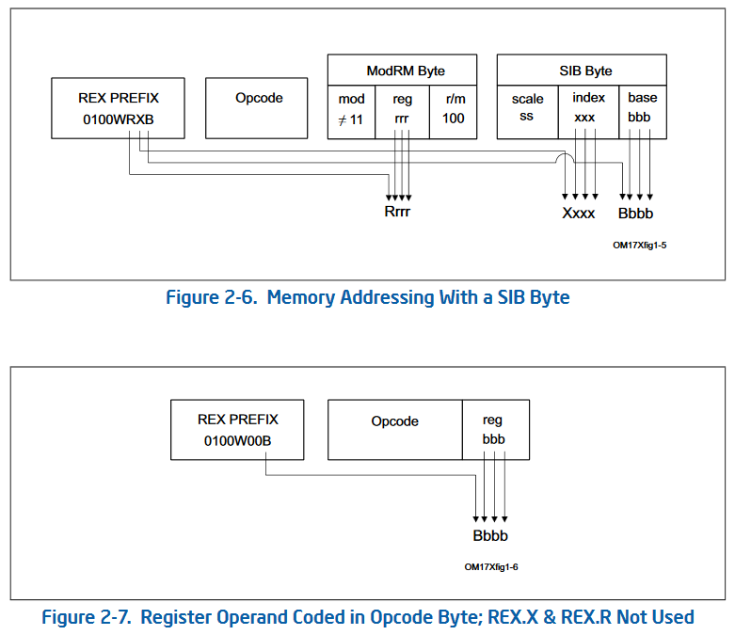
In 64 bits

Slide 47
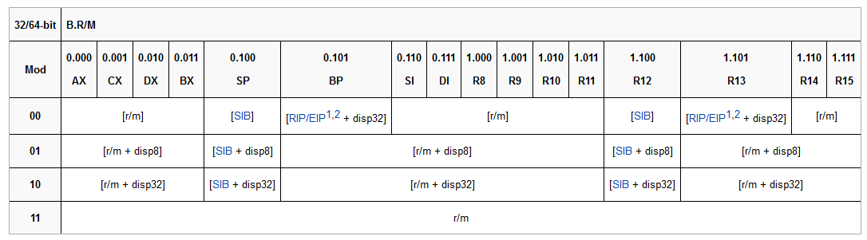
ModRM in 64 bit

Slide 48
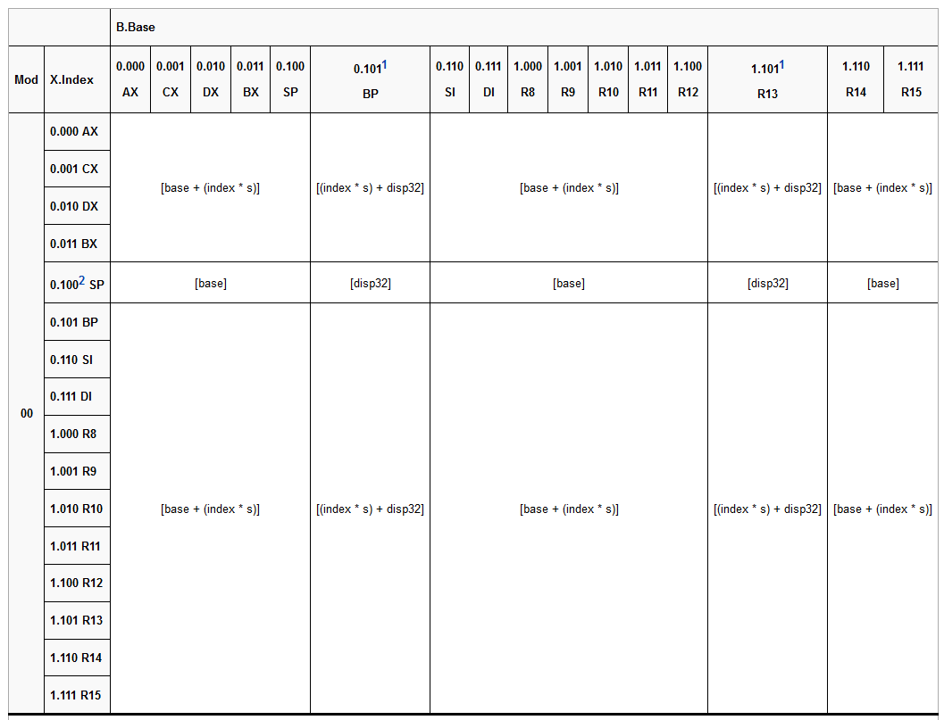
SIB in 64 bits

Slide 49
The Ultimate Authority
https://software.intel.com/en-us/articles/intel-sdm
All 5066 pages of the full glory…

Slide 50
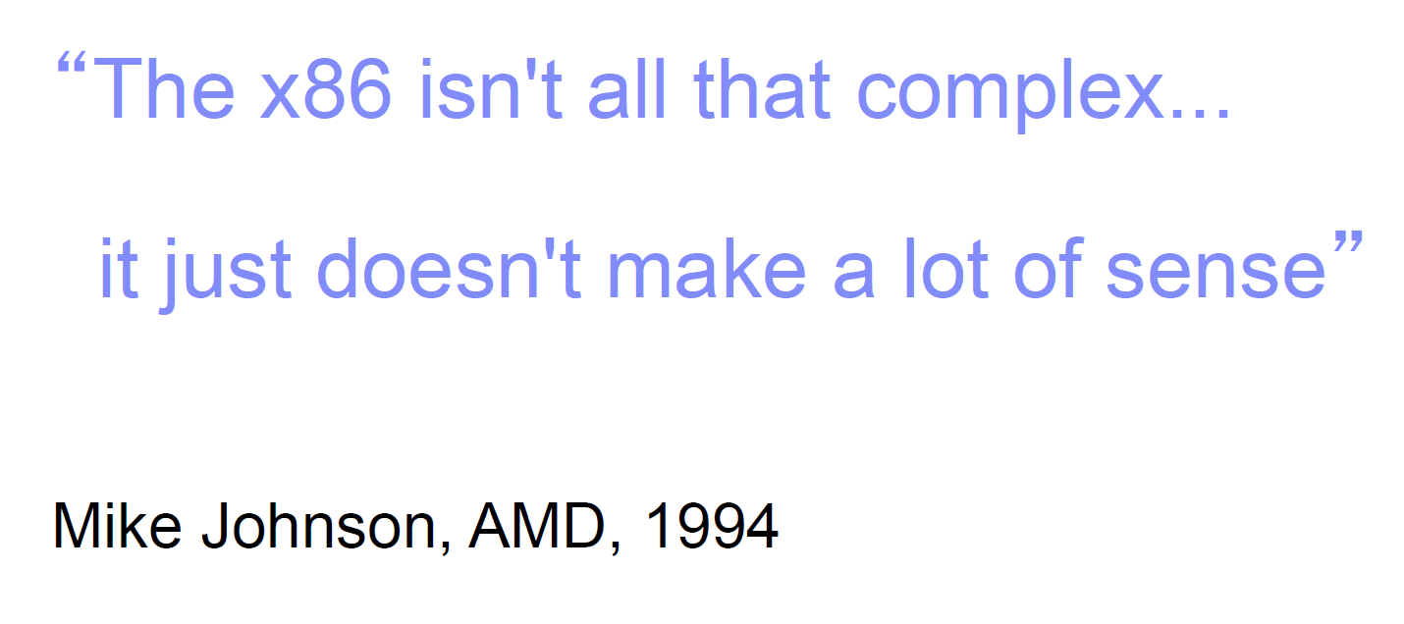

Slide 51
IA programming
Slides adapted from CMU’s 2002 mounting of 15-213 module

Slide 52
Assembly Programmer’s View
CPU
Addresses
Memory
E
I
P
Registers
Data
Condition
Codes
Instructions
Object Code
Program Data
OS Data
Programmer-Visible State
EIP Program Counter
Address of next instruction
Register File
Heavily used program data
Condition Codes
Store status information about most recent arithmetic operation
Used for conditional branching
Stack
Memory
Byte addressable array
Code, user data, (some) OS data
Includes stack used to support procedures

Slide 53
Turning C into Object Code
Code in files p1.c p2.c
Compile with command: gcc -O p1.c p2.c -o p
Use optimizations (-O)
Put resulting binary in file p
text
C program (p1.c p2.c)
Compiler (gcc -S)
Asm program (p1.s p2.s)
text
Assembler (gcc or as)
Static libraries (.a)
binary
Object program (p1.o p2.o)
Linker (gcc or ld)
binary
Executable program (p)

Slide 54
Compiling Into Assembly
C Code
Generated Assembly
int sum(int x, int y)
{
int t = x+y;
return t;
}
_sum:
pushl %ebp
movl %esp,%ebp
movl 12(%ebp),%eax
addl 8(%ebp),%eax
movl %ebp,%esp
popl %ebp
ret
Obtain with command
gcc -O -S code.c
Produces file code.s

Slide 55
Assembly Characteristics
Minimal Data Types
“Integer” data of 1, 2, or 4 bytes
Data values
Addresses (untyped pointers)
Floating point data of 4, 8, or 10 bytes
No aggregate types such as arrays or structures
Just contiguously allocated bytes in memory
Primitive Operations
Perform arithmetic function on register or memory data
Transfer data between memory and register
Load data from memory into register
Store register data into memory
Transfer control
Unconditional jumps to/from procedures
Conditional branches

Slide 56
Beware: the two x86 assembly syntax
Intel syntax: destination operand before source operands
AT&T syntax: source operands come first before destination operand
Different assemblers use one or both

Slide 57
Machine Instruction Example
C Code
Add two signed integers
Assembly
Add 2 4-byte integers
“Long” words in GCC parlance
Same instruction whether signed or unsigned
Operands:
x: Register %eax
y: Memory M[%ebp+8]
t: Register %eax
Return function value in %eax
Object Code
3-byte instruction
Stored at address 0x401046
int t = x+y;
addl 8(%ebp),%eax
Similar to expression x += y
0x401046: 03 45 08

Slide 58
Disassembling Object Code
Disassembled
00401040 <_sum>:
0: 55 push %ebp
1: 89 e5 mov %esp,%ebp
3: 8b 45 0c mov 0xc(%ebp),%eax
6: 03 45 08 add 0x8(%ebp),%eax
9: 89 ec mov %ebp,%esp
b: 5d pop %ebp
c: c3 ret
d: 8d 76 00 lea 0x0(%esi),%esi
Disassembler
objdump -d p
Useful tool for examining object code
Analyzes bit pattern of series of instructions
Produces approximate rendition of assembly code
Can be run on either a.out (complete executable) or .o file

Slide 59
Moving Data
Moving Data
movl Source,Dest:
Move 4-byte (“long”) word
Lots of these in typical code
Operand Types
Immediate: Constant integer data
Like C constant, but prefixed with ‘$’
E.g., $0x400, $-533
Encoded with 1, 2, or 4 bytes
Register: One of 8 integer registers
But %esp and %ebp reserved for special use
Others have special uses for particular instructions
Memory: 4 consecutive bytes of memory
Various “address modes”
%eax
%edx
%ecx
%ebx
%esi
%edi
%esp
%ebp

Slide 60
movl Operand Combinations
Source
Destination
C Analog
Reg
movl $0x4,%eax
temp = 0x4;
Imm
Mem
movl $-147,(%eax)
*p = -147;
Reg
movl %eax,%edx
temp2 = temp1;
movl
Reg
Mem
movl %eax,(%edx)
*p = temp;
Mem
Reg
movl (%eax),%edx
temp = *p;
Cannot do memory-memory transfers with single instruction

Slide 61
Simple Addressing Modes
Normal (R) Mem[Reg[R]]
Register R specifies memory address
movl (%ecx),%eax
Displacement D(R) Mem[Reg[R]+D]
Register R specifies start of memory region
Constant displacement D specifies offset
movl 8(%ebp),%edx

Slide 62
Using Simple Addressing Modes
swap:
pushl %ebp
movl %esp,%ebp
pushl %ebx
movl 12(%ebp),%ecx
movl 8(%ebp),%edx
movl (%ecx),%eax
movl (%edx),%ebx
movl %eax,(%edx)
movl %ebx,(%ecx)
movl -4(%ebp),%ebx
movl %ebp,%esp
popl %ebp
ret
Set
Up
void swap(int *xp, int *yp)
{
int t0 = *xp;
int t1 = *yp;
*xp = t1;
*yp = t0;
}
Body
Finish

Slide 63
Understanding Swap
•
•
•
Stack
void swap(int *xp, int *yp)
{
int t0 = *xp;
int t1 = *yp;
*xp = t1;
*yp = t0;
}
Offset
12
yp
8
xp
4
Rtn adr
0
Old %ebp
%ebp
Register Variable
%ecx yp
%edx xp
%eax t1
%ebx t0
-4
Old %ebx
movl 12(%ebp),%ecx # ecx = yp
movl 8(%ebp),%edx # edx = xp
movl (%ecx),%eax # eax = *yp (t1)
movl (%edx),%ebx # ebx = *xp (t0)
movl %eax,(%edx) # *xp = eax
movl %ebx,(%ecx) # *yp = ebx

Slide 64
Understanding Swap
Address
%eax
123
0x124
%edx
456
0x120
%ecx
0x11c
%ebx
0x118
Offset
0x114
%esi
yp
12
0x120
0x110
%edi
xp
8
0x124
0x10c
%esp
4
Rtn adr
0x108
%ebp
0x104
%ebp
0
0x104
-4
0x100
movl 12(%ebp),%ecx # ecx = yp
movl 8(%ebp),%edx # edx = xp
movl (%ecx),%eax # eax = *yp (t1)
movl (%edx),%ebx # ebx = *xp (t0)
movl %eax,(%edx) # *xp = eax
movl %ebx,(%ecx) # *yp = ebx

Slide 65
Understanding Swap
%eax
Address
%edx
123
0x124
456
0x120
%ecx
0x120
0x11c
%ebx
0x118
%esi
Offset
0x114
yp
12
0x120
0x110
%edi
xp
8
0x124
0x10c
%esp
4
Rtn adr
0x108
%ebp
0x104
%ebp
0
0x104
-4
0x100
movl 12(%ebp),%ecx # ecx = yp
movl 8(%ebp),%edx # edx = xp
movl (%ecx),%eax # eax = *yp (t1)
movl (%edx),%ebx # ebx = *xp (t0)
movl %eax,(%edx) # *xp = eax
movl %ebx,(%ecx) # *yp = ebx

Slide 66
Understanding Swap
%eax
Address
123
0x124
%edx
0x124
456
0x120
%ecx
0x120
0x11c
%ebx
0x118
Offset
0x114
%esi
yp
12
0x120
0x110
%edi
xp
8
0x124
0x10c
4
Rtn adr
0x108
%esp
0
%ebp
0x104
%ebp
0x104
-4
0x100
movl 12(%ebp),%ecx # ecx = yp
movl 8(%ebp),%edx # edx = xp
movl (%ecx),%eax # eax = *yp (t1)
movl (%edx),%ebx # ebx = *xp (t0)
movl %eax,(%edx) # *xp = eax
movl %ebx,(%ecx) # *yp = ebx

Slide 67
Understanding Swap
Address
123
0x124
%eax
456
456
0x120
%edx
0x124
0x11c
%ecx
0x120
0x118
Offset
0x114
%ebx
yp
12
0x120
0x110
%esi
xp
8
0x124
0x10c
4
Rtn adr
0x108
%edi
%ebp
0
0x104
%esp
-4
0x100
%ebp
0x104
movl 12(%ebp),%ecx # ecx = yp
movl 8(%ebp),%edx # edx = xp
movl (%ecx),%eax # eax = *yp (t1)
movl (%edx),%ebx # ebx = *xp (t0)
movl %eax,(%edx) # *xp = eax
movl %ebx,(%ecx) # *yp = ebx

Slide 68
Understanding Swap
Address
123
0x124
%eax
456
456
0x120
%edx
0x124
0x11c
0x118
%ecx
0x120
Offset
0x114
%ebx
123
yp
12
0x120
0x110
xp
8
0x124
0x10c
%esi
4
Rtn adr
0x108
%edi
%ebp
0
0x104
%esp
-4
0x100
%ebp
0x104
movl 12(%ebp),%ecx # ecx = yp
movl 8(%ebp),%edx # edx = xp
movl (%ecx),%eax # eax = *yp (t1)
movl (%edx),%ebx # ebx = *xp (t0)
movl %eax,(%edx) # *xp = eax
movl %ebx,(%ecx) # *yp = ebx

Slide 69
Understanding Swap
Address
%eax
456
456
0x124
%edx
0x124
456
0x120
0x11c
%ecx
0x120
0x118
%ebx
123
Offset
0x114
yp
12
0x120
0x110
%esi
xp
8
0x124
0x10c
%edi
4
Rtn adr
0x108
%esp
%ebp
0
0x104
-4
0x100
%ebp
0x104
movl 12(%ebp),%ecx # ecx = yp
movl 8(%ebp),%edx # edx = xp
movl (%ecx),%eax # eax = *yp (t1)
movl (%edx),%ebx # ebx = *xp (t0)
movl %eax,(%edx) # *xp = eax
movl %ebx,(%ecx) # *yp = ebx

Slide 70
Understanding Swap
Address
456
0x124
%eax
456
123
0x120
%edx
0x124
0x11c
%ecx
0x120
0x118
Offset
0x114
%ebx
123
yp
12
0x120
0x110
%esi
xp
8
0x124
0x10c
%edi
4
Rtn adr
0x108
%ebp
0
0x104
%esp
-4
0x100
%ebp
0x104
movl 12(%ebp),%ecx # ecx = yp
movl 8(%ebp),%edx # edx = xp
movl (%ecx),%eax # eax = *yp (t1)
movl (%edx),%ebx # ebx = *xp (t0)
movl %eax,(%edx) # *xp = eax
movl %ebx,(%ecx) # *yp = ebx

Slide 71
Indexed Addressing Modes
Most General Form
D(Rb,Ri,S) Mem[Reg[Rb]+S*Reg[Ri]+ D]
D: Constant “displacement” 1, 2, or 4 bytes
Rb: Base register: Any of 8 integer registers
Ri: Index register: Any, except for %esp
Unlikely you’d use %ebp, either
S: Scale: 1, 2, 4, or 8
Special Cases
(Rb,Ri) Mem[Reg[Rb]+Reg[Ri]]
D(Rb,Ri) Mem[Reg[Rb]+Reg[Ri]+D]
(Rb,Ri,S) Mem[Reg[Rb]+S*Reg[Ri]]

Slide 72
Address Computation Examples
%edx
0xf000
%ecx
0x100
Expression | Computation | Address
0x8(%edx) | 0xf000 + 0x8 | 0xf008
(%edx,%ecx) | 0xf000 + 0x100 | 0xf100
(%edx,%ecx,4) | 0xf000 + 4*0x100 | 0xf400
0x80(,%edx,2) | 2*0xf000 + 0x80 | 0x1e080

Slide 73
Address Computation Instruction
leal Src,Dest
Src is address mode expression
Set Dest to address denoted by expression
Uses
Computing address without doing memory reference
E.g., translation of p = &x[i];
Computing arithmetic expressions of the form x + k*y
k = 1, 2, 4, or 8.

Slide 74
Some Arithmetic Operations
Format Computation
Two Operand Instructions
addl Src,Dest Dest = Dest + Src
subl Src,Dest Dest = Dest - Src
imull Src,Dest Dest = Dest * Src
sall Src,Dest Dest = Dest << Src Also called shll
sarl Src,Dest Dest = Dest >> Src Arithmetic
shrl Src,Dest Dest = Dest >> Src Logical
xorl Src,Dest Dest = Dest ^ Src
andl Src,Dest Dest = Dest & Src
orl Src,Dest Dest = Dest | Src

Slide 75
Some Arithmetic Operations
Format Computation
One Operand Instructions
incl Dest Dest = Dest + 1
decl Dest Dest = Dest - 1
negl Dest Dest = - Dest
notl Dest Dest = ~ Dest

Slide 76
Using leal for Arithmetic Expressions
arith:
pushl %ebp
movl %esp,%ebp
movl 8(%ebp),%eax
movl 12(%ebp),%edx
leal (%edx,%eax),%ecx
leal (%edx,%edx,2),%edx
sall $4,%edx
addl 16(%ebp),%ecx
leal 4(%edx,%eax),%eax
imull %ecx,%eax
movl %ebp,%esp
popl %ebp
ret
Set
Up
int arith
(int x, int y, int z)
{
int t1 = x+y;
int t2 = z+t1;
int t3 = x+4;
int t4 = y * 48;
int t5 = t3 + t4;
int rval = t2 * t5;
return rval;
}
Body
Finish

Slide 77
Understanding arith
•
•
•
int arith
(int x, int y, int z)
{
int t1 = x+y;
int t2 = z+t1;
int t3 = x+4;
int t4 = y * 48;
int t5 = t3 + t4;
int rval = t2 * t5;
return rval;
}
Stack
Offset
16
z
12
y
8
x
4
Rtn adr
0
Old %ebp
%ebp
movl 8(%ebp),%eax # eax = x
movl 12(%ebp),%edx # edx = y
leal (%edx,%eax),%ecx # ecx = x+y (t1)
leal (%edx,%edx,2),%edx # edx = 3*y
sall $4,%edx # edx = 48*y (t4)
addl 16(%ebp),%ecx # ecx = z+t1 (t2)
leal 4(%edx,%eax),%eax # eax = 4+t4+x (t5)
imull %ecx,%eax # eax = t5*t2 (rval)

Slide 78
Understanding arith
# eax = x
movl 8(%ebp),%eax
# edx = y
movl 12(%ebp),%edx
# ecx = x+y (t1)
leal (%edx,%eax),%ecx
# edx = 3*y
leal (%edx,%edx,2),%edx
# edx = 48*y (t4)
sall $4,%edx
# ecx = z+t1 (t2)
addl 16(%ebp),%ecx
# eax = 4+t4+x (t5)
leal 4(%edx,%eax),%eax
# eax = t5*t2 (rval)
imull %ecx,%eax
int arith
(int x, int y, int z)
{
int t1 = x+y;
int t2 = z+t1;
int t3 = x+4;
int t4 = y * 48;
int t5 = t3 + t4;
int rval = t2 * t5;
return rval;
}

Slide 79
Condition Codes
Single Bit Registers
CF Carry Flag SF Sign Flag
ZF Zero Flag OF Overflow Flag
Implicitly Set By Arithmetic Operations
addl Src,Dest
C analog: t = a + b
CF set if carry out from most significant bit
Used to detect unsigned overflow
ZF set if t == 0
SF set if t < 0
OF set if two’s complement overflow
(a>0 && b>0 && t<0) || (a<0 && b<0 && t>=0)
Not Set by leal instruction

Slide 80
Setting Condition Codes (cont.)
Explicit Setting by Compare Instruction
cmpl Src2,Src1
cmpl b,a like computing a-b without setting destination
CF set if carry out from most significant bit
Used for unsigned comparisons
ZF set if a == b
SF set if (a-b) < 0
OF set if two’s complement overflow
(a>0 && b<0 && (a-b)<0) || (a<0 && b>0 && (a-b)>0)

Slide 81
Setting Condition Codes (cont.)
Explicit Setting by Test instruction
testl Src2,Src1
Sets condition codes based on value of Src1 & Src2
Useful to have one of the operands be a mask
testl b,a like computing a&b without setting destination
ZF set when a&b == 0
SF set when a&b < 0

Slide 82
Jumping
jX Instructions
Jump to different part of code depending on condition codes
jX
Condition
Description
jmp
1
Unconditional
je
ZF
Equal / Zero
jne
~ZF
Not Equal / Not Zero
js
SF
Negative
jns
~SF
Nonnegative
jg
~(SF^OF)&~ZF
Greater
(Signed)
jge
~(SF^OF)
Greater or Equal
(Signed)
jl
(SF^OF)
Less
(Signed)
jle
(SF^OF)|ZF
Less or Equal
(Signed)
ja
~CF&~ZF
Above (unsigned)
jb
CF
Below (unsigned)

Slide 83
Conditional Branch Example
_max:
pushl %ebp
movl %esp,%ebp
movl 8(%ebp),%edx
movl 12(%ebp),%eax
cmpl %eax,%edx
jle L9
movl %edx,%eax
L9:
movl %ebp,%esp
popl %ebp
ret
Set
Up
int max(int x, int y)
{
if (x > y)
return x;
else
return y;
}
Body
Finish

Slide 84
IA32 Stack
Region of memory managed with stack discipline
Grows toward lower addresses
Register %esp indicates lowest stack address
address of top element
Stack “Bottom”
Increasing
Addresses
Stack Grows
Down
Stack
Pointer
%esp
Stack “Top”

Slide 85
IA32 Stack Pushing
Stack “Bottom”
Pushing
pushl Src
Fetch operand at Src
Decrement %esp by 4
Write operand at address given by %esp
Increasing
Addresses
Stack Grows
Down
Stack
Pointer
%esp
-4
Stack “Top”

Slide 86
IA32 Stack Popping
Stack “Bottom”
Popping
popl Dest
Read operand at address given by %esp
Increment %esp by 4
Write to Dest
Increasing
Addresses
Stack
Pointer
%esp
Stack Grows
Down
+4
Stack “Top”

Slide 87
Stack Operation Examples
pushl %eax
popl %edx
0x110
0x110
0x110
0x10c
0x10c
0x10c
0x108
123
0x108
123
0x108
123
0x104
213
0x104
213
%eax
213
%eax
213
%eax
213
%edx
555
%edx
555
%edx
555
213
%esp
0x108
%esp
0x108
0x104
%esp
0x104
0x108

Slide 88
Procedure Control Flow
Use stack to support procedure call and return
Procedure call:
call label Push return address on stack; Jump to label
Return address value
Address of instruction beyond call
Example from disassembly
804854e: e8 3d 06 00 00 call 8048b90 <main>
8048553: 50 pushl %eax
Return address = 0x8048553
Procedure return:
ret Pop address from stack; Jump to address

Slide 89
IA32/Linux Stack Frame
Current Stack Frame (“Top” to Bottom)
Parameters for function about to call
“Argument build”
Local variables
If can’t keep in registers
Saved register context
Old frame pointer
Caller Stack Frame
Return address
Pushed by call instruction
Arguments for this call
Caller
Frame
Arguments
Frame Pointer
(%ebp)
Return Addr
Old %ebp
Saved
Registers
+
Local
Variables
Argument
Build
Stack Pointer
(%esp)

Slide 90
Revisiting swap
Calling swap from call_swap
int zip1 = 15213;
int zip2 = 91125;
void call_swap()
{
swap(&zip1, &zip2);
}
call_swap:
• • •
pushl $zip2 # Global Var
pushl $zip1 # Global Var
call swap
• • •
•
•
•
Resulting
Stack
void swap(int *xp, int *yp)
{
int t0 = *xp;
int t1 = *yp;
*xp = t1;
*yp = t0;
}
&zip2
&zip1
Rtn adr
%esp

Slide 91
Revisiting swap
void swap(int *xp, int *yp)
{
int t0 = *xp;
int t1 = *yp;
*xp = t1;
*yp = t0;
}
swap:
pushl %ebp
movl %esp,%ebp
pushl %ebx
movl 12(%ebp),%ecx
movl 8(%ebp),%edx
movl (%ecx),%eax
movl (%edx),%ebx
movl %eax,(%edx)
movl %ebx,(%ecx)
movl -4(%ebp),%ebx
movl %ebp,%esp
popl %ebp
ret
Set
Up
Body
Finish

Slide 92
swap Setup #1
Resulting
Stack
Entering
Stack
•
•
•
%ebp
•
•
•
%ebp
&zip2
yp
&zip1
xp
Rtn adr
%esp
Rtn adr
swap:
pushl %ebp
movl %esp,%ebp
pushl %ebx
Old %ebp
%esp

Slide 93
swap Setup #2
Resulting
Stack
Entering
Stack
•
•
•
%ebp
•
•
•
&zip2
yp
&zip1
xp
Rtn adr
%esp
Rtn adr
swap:
pushl %ebp
movl %esp,%ebp
pushl %ebx
Old %ebp
%ebp
%esp

Slide 94
swap Setup #3
Entering
Stack
Resulting
Stack
•
•
•
%ebp
•
•
•
&zip2
yp
&zip1
xp
Rtn adr
%esp
Rtn adr
swap:
pushl %ebp
movl %esp,%ebp
pushl %ebx
Old %ebp
%ebp
Old %ebx
%esp

Slide 95
Effect of swap Setup
Entering
Stack
Resulting
Stack
•
•
•
%ebp
•
•
•
Offset
(relative to %ebp)
&zip2
12
yp
&zip1
8
xp
Rtn adr
%esp
4
Rtn adr
0
Old %ebp
%ebp
movl 12(%ebp),%ecx # get yp
movl 8(%ebp),%edx # get xp
. . .
Old %ebx
%esp
Body

Slide 96
swap Finish #1
swap’s
Stack
•
•
•
•
•
•
Offset
Offset
12
yp
12
yp
8
xp
8
xp
4
Rtn adr
4
Rtn adr
0
Old %ebp
%ebp
0
Old %ebp
%ebp
-4
Old %ebx
%esp
-4
Old %ebx
%esp
movl -4(%ebp),%ebx
movl %ebp,%esp
popl %ebp
ret

Slide 97
swap Finish #2
swap’s
Stack
•
•
•
•
•
•
swap’s
Stack
Offset
Offset
12
yp
12
yp
8
xp
8
xp
4
Rtn adr
4
Rtn adr
0
Old %ebp
%ebp
0
Old %ebp
%ebp
-4
Old %ebx
%esp
%esp
movl -4(%ebp),%ebx
movl %ebp,%esp
popl %ebp
ret

Slide 98
swap Finish #3
•
•
•
swap’s
Stack
•
•
•
%ebp
swap’s
Stack
Offset
Offset
12
yp
12
yp
8
xp
8
xp
4
Rtn adr
4
Rtn adr
Old %ebp
%esp
0
%ebp
%esp
movl -4(%ebp),%ebx
movl %ebp,%esp
popl %ebp
ret

Slide 99
swap Finish #4
Observation
Saved & restored register %ebx
Didn’t do so for %eax, %ecx, or %edx
swap’s
Stack
•
•
•
%ebp
•
•
•
%ebp
Exiting
Stack
Offset
12
yp
&zip2
8
xp
&zip1
%esp
4
Rtn adr
%esp
movl -4(%ebp),%ebx
movl %ebp,%esp
popl %ebp
ret

Slide 100
IA32/Linux Register Usage
Integer Registers
Two have special uses
%ebp, %esp
Three managed as callee-save
%ebx, %esi, %edi
Old values saved on stack prior to using
Three managed as caller-save
%eax, %edx, %ecx
Do what you please, but expect any callee to do so, as well
Register %eax also stores returned value
%eax
Caller-Save
Temporaries
%edx
%ecx
%ebx
Callee-Save
Temporaries
%esi
%edi
%esp
Special
%ebp

Slide 101
Linux x86-64 Calling Convention
Uses the System V AMD64 ABI
See: https://en.wikipedia.org/wiki/X86_calling_conventions
Full details: https://web.archive.org/web/20160801075146/http://www.x86-64.org/documentation/abi.pdf

Slide 102
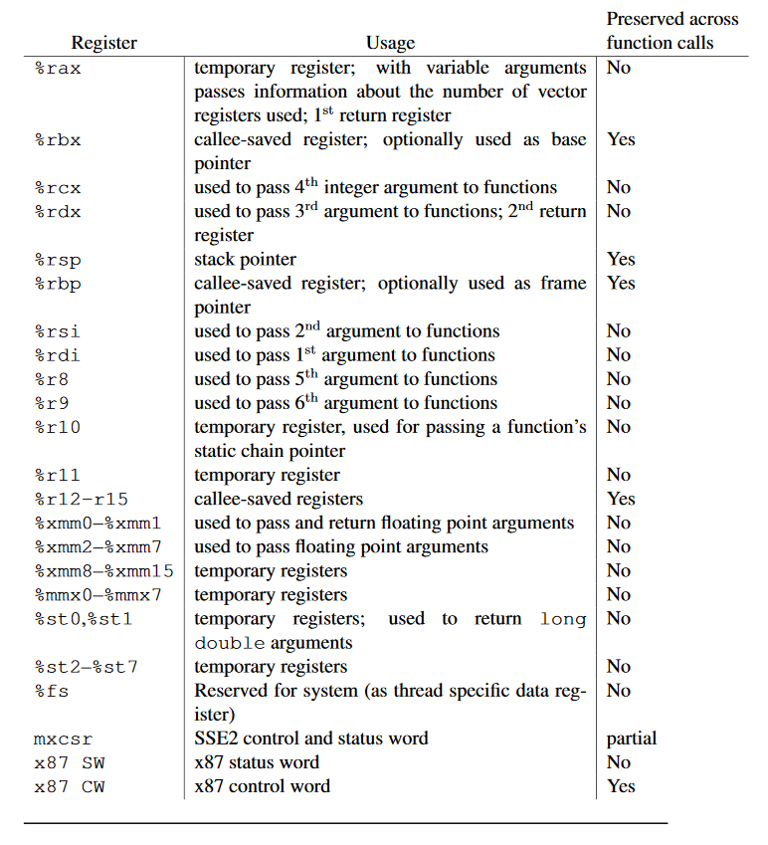
Linux 64 bit Procedure Call Register Usage

Slide 103
END

